Slide 1


Slide 2
Your application throws OutOfMemoryError due to Strings. Why does this happen?
Strings in Java are immutable. Every time you change a String, Java creates a new String object in memory.
If this happens repeatedly, especially inside loops, memory fills up and the JVM throws OutOfMemoryError.
Example:
static List<String> logs = new ArrayList<>();
public void logError(String msg) {
logs.add(msg);
}
Golden Rule
Static + Mutable + Growing data = Memory leak

Slide 3
How would you optimize heavy string concatenation inside loops?
String concatenation using + inside loops is expensive because Strings are immutable. Each + creates a new String object, leading to high memory usage and slow performance.
String report = "";
for (Order order : orders) {
report = report + order.getId() + "," + order.getAmount() + "\n";
}
StringBuilder report = new StringBuilder();
for (Order order : orders) {
report.append(order.getId())
.append(",")
.append(order.getAmount())
.append("\n");
}
String finalReport = report.toString();

Slide 4
How do you handle exceptions in REST APIs in real-world applications?
In real projects, we do not handle exceptions inside every controller. Instead, we handle them centrally and return clean, meaningful HTTP responses to the client.
In Spring Boot, this is done using @ControllerAdvice.
❌ Do NOT do this in Controller
(Avoid try–catch in every API)
@GetMapping("/users/{id}")
public User getUser(@PathVariable String id) {
try {
return userService.getUser(id);
} catch (Exception e) {
throw new RuntimeException(e);
}
}
Service layer (throw business exception)
public User getUser(String id) {
return userRepo.findById(id)
.orElseThrow(() -> new UserNotFoundException("User not found"));
}
Global Exception Handler
@RestControllerAdvice
class GlobalHandler {
@ExceptionHandler(UserNotFoundException.class)
ResponseEntity<String> handle(UserNotFoundException e) {
return ResponseEntity.status(404).body(e.getMessage());
}
}

Slide 5
How do you log exceptions without losing the root cause?
To avoid losing the root cause, always log the exception object along with a meaningful message.
❌ Wrong way (very common mistake)
catch (Exception e) {
log.error(e.getMessage());
}
❌ Loses stack trace ❌ Hard to debug production issues
Correct way (real-world practice)
catch (Exception e) {
log.error("Order processing failed", e);
}

Slide 6
How would you design a thread-safe in-memory cache?
Use a ConcurrentHashMap, store immutable values, and control the cache size.
In real projects, many users hit the application at the same time. To avoid repeated database calls, we store frequently used data in memory.
But if the cache keeps growing forever, memory increases and the application crashes.
So the cache must be Thread-safe & Size-controlled
real-world example
private final Map<String, User> cache = new ConcurrentHashMap<>();
public User getUser(String id) {
return cache.computeIfAbsent(id, this::loadUserFromDB);
}
Thread-safe cache with simple size control
private final Map<String, User> cache = new ConcurrentHashMap<>();
private static final int MAX_CACHE_SIZE = 1000;
public User getUser(String id) {
if (cache.size() >= MAX_CACHE_SIZE) {
cache.clear(); // simple eviction
}
return cache.computeIfAbsent(id, this::loadUserFromDB);
}

Slide 7
Why does ConcurrentHashMap not allow null keys or values?
To avoid ambiguity during concurrent access.
ConcurrentHashMap does not allow null keys or values to avoid confusion and race conditions in multi-threaded environments.
What problem does null cause?
In a concurrent map:
get(key) returning null could mean → the key is not present →OR the key exists but value is null
With multiple threads, this becomes ambiguous and unsafe.
example
map.get("A"); // returns null
In ConcurrentHashMap, Java must clearly know:
Is "A" missing?
Or is "A" mapped to null?
In multi-threaded code, this ambiguity can cause wrong logic decisions.

Slide 8
Sorting millions of objects — Comparable or Comparator? Why?
Use Comparator, not Comparable.
Comparable fixes one natural order inside the class
Comparator lets you choose sorting logic at runtime
When sorting millions of objects, flexibility and clarity matter.
Real-world example
Comparator<Order> byAmount =
Comparator.comparing(Order::getAmount);
orders.sort(byAmount);
Later, if business needs change:
Comparator<Order> byDate =
Comparator.comparing(Order::getCreatedDate);
orders.sort(byDate);
No code change inside Order class.

Slide 9
How do you avoid ConcurrentModificationException?
ConcurrentModificationException happens when a collection is modified while it’s being iterated.
Rule: Never modify a collection directly inside a loop.
Example:
In a notification service, removing inactive users while looping over the list caused random crashes.
for (User user : users) {
if (!user.isActive()) {
users.remove(user); // ❌ modifying list during iteration
} } Fix:
Use Iterator.remove() (most common)
Iterator<User> it = users.iterator();
while (it.hasNext()) {
if (!it.next().isActive()) {
it.remove();
} }
2. Use concurrent collections
List<User> users = new CopyOnWriteArrayList<>();
//Iterate over a copy
for (User u : new ArrayList<>(users)) {
if (!u.isActive()) {
users.remove(u);
} }

Slide 10
When would you choose TreeMap over HashMap in real systems?
Use TreeMap when order or range queries are required, and HashMap when only fast key-based lookup is needed.
Example 1: Account Statement (TreeMap)
Why TreeMap? Order matters.
Use case: Bank needs to generate an account statement sorted by transaction date.
TreeMap<LocalDateTime, Transaction> transactions = new TreeMap<>();
✔ Get earliest / latest transaction ✔ Range queries (monthly statement)
TreeMap is used because data must be ordered
Example 2: Customer Lookup (HashMap)
Why HashMap? Speed matters.
Use case: Fetch customer details using account number.
HashMap<String, Customer> customers = new HashMap<>();
✔ Fast lookup ✔ Order not required
HashMap is used because only quick access is needed

Slide 11
Streams vs loops — which is better and why?
Use Streams:
List<User> activeUsers =
users.stream()
.filter(User::isActive)
.collect(Collectors.toList());
Using Loops:
List<User> activeUsers = new ArrayList<>();
for (User u : users) {
if (u.isActive()) {
activeUsers.add(u);
}
}
Which is better?
Streams improve readability, while loops give better performance and control—real projects use both depending on the use case.
Streams → cleaner, more readable, declarative
Used in service-layer business rules.
Loops → faster, more control, better for performance-critical code
Used in batch jobs / large data processing.

Slide 12
When should you NOT use parallel streams?
Parallel stream = many threads working together.
This is good only when each task is heavy and independent. Don’t use parallel streams for I/O work, shared data, small collections, or when order matters.
Database call
API call
File read
→ Threads just wait, not work. →More threads = more waiting = slower.
users.parallelStream().forEach(list::add);
→Many threads change the same list → Data breaks or becomes wrong
Real-life example:
If 5 people try to write in one notebook at the same time → chaos ❌ If each person has separate work → faster ✅

Slide 13
How do Streams impact performance with large data sets?
They add overhead due to lambda calls and object creation. Example: For ~1M records, a traditional for-loop is often faster than streams, especially for simple operations.

Slide 14
Your application is slow under high load. How would Virtual Threads help?
When many users hit your app at the same time, normal threads are heavy and limited. If threads are busy waiting for DB or API responses, the app becomes slow.
Virtual Threads are very lightweight, so:
You can create thousands or millions of them
Blocking (waiting) is cheap, not expensive
Requests don’t get stuck waiting for free threads

Slide 15
You see inconsistent data in multi-threaded code. How do you debug it?
Reproduce the issue under high load or multiple threads
Check shared mutable data (common root cause)
Verify proper use of synchronization / locks / volatile / atomic classes
Look for race conditions and missing thread-safety
Add logging with thread names to trace execution
Use thread dumps to analyze thread states and locks

Slide 16
Explain a deadlock scenario you encountered and how you fixed it.
Two threads were trying to acquire two locks in different order.
Thread-1 locks A
Thread-2 locks B
Thread-1 waits for B
Thread-2 waits for A
Both wait forever → DEADLOCK
How I fixed it:
Enforced a fixed lock order (always lock A before B)
Reduced synchronized scope
In some cases, used tryLock() with timeout to avoid infinite waiting

Slide 17
Explain a deadlock scenario you encountered and how you fixed it.
class DeadlockExample {
private static final Object LOCK_A = new Object();
private static final Object LOCK_B = new Object();
public static void main(String[] args) {
Thread t1 = new Thread(() -> {
synchronized (LOCK_A) {
System.out.println("Thread-1 locked A");
sleep();
synchronized (LOCK_B) {
System.out.println("Thread-1 locked B");
}
}
});
Thread t2 = new Thread(() -> {
synchronized (LOCK_B) {
System.out.println("Thread-2 locked B");
sleep();
synchronized (LOCK_A) {
System.out.println("Thread-2 locked A");
}
}
});
t1.start();
t2.start();
}
private static void sleep() {
try { Thread.sleep(100); } catch (Exception ignored) {}
}
}

Slide 18
Explain a deadlock scenario you encountered and how you fixed it.
class DeadlockExample {
private static final Object LOCK_A = new Object();
private static final Object LOCK_B = new Object();
public static void main(String[] args) {
Thread t1 = new Thread(() -> {
synchronized (LOCK_A) {
System.out.println("Thread-1 locked A");
sleep();
synchronized (LOCK_B) {
System.out.println("Thread-1 locked B");
}
}
});
Thread t2 = new Thread(() -> {
synchronized (LOCK_A) {/ / Always A first
System.out.println("Thread-2 locked B");
sleep();
synchronized (LOCK_B) {// Then B
System.out.println("Thread-2 locked A");
}
}
});
t1.start();
t2.start();
}
private static void sleep() {
try { Thread.sleep(100); } catch (Exception ignored) {}
}
}

Slide 19
Application memory keeps increasing. How do you investigate it?
I analyze heap usage, take heap dumps, and identify objects that are retained longer than expected to find memory leaks.
Check if it’s a memory leak or expected growth
Monitor heap usage using tools (VisualVM / JConsole / JMC)
Take heap dump and analyze retained objects
Look for:
Unclosed resources (connections, streams)
Growing collections (Maps, Caches)
Static references holding objects
Check GC logs for frequent/full GCs
Reproduce the issue under load

Slide 20
How do you identify a memory leak in Java?
Observe heap memory keeps growing after GC
Monitor memory using VisualVM / JConsole / JMC
Take heap dumps at different times
Compare dumps to find growing objects
Look for:
Static references
Large collections
Unclosed resources
Analyze GC logs for frequent Full GCs

Slide 21
What JVM tools have you used ?
I mainly use JFR with JMC because:
They are built into the JDK (no extra setup)
Have very low overhead, safe for production
Provide a complete view of CPU, memory, GC, and threads
Are replacing ad-hoc monitoring tools in real-world projects

Slide 22
Difference between memory leak and memory overflow?
A memory leak slowly consumes memory, while memory overflow occurs when the JVM runs out of heap space.
Memory leak → Memory keeps growing over time
Memory overflow → JVM cannot allocate more memory

Slide 23
How do you troubleshoot high CPU usage in a Java application?
Take thread dumps.
Example: Infinite loop found.

Slide 24
How would you break a Singleton?
Using reflection or serialization.

Slide 25
How do you protect a Singleton from reflection and serialization?
Use enum Singleton.

Slide 27
Why is Enum Singleton the safest approach in Java?
JVM guarantees only one instance of an enum
Thread-safe by default
Safe from reflection attacks
Safe from serialization issues
No need for synchronized or volatile
enum Singleton {
INSTANCE;
}

Slide 28


Slide 29
When would you use volatile instead of synchronized?
Use volatile instead of synchronized when:
You only need visibility, not locking
One thread updates a variable and others only read
In short: 👉 volatile = see latest value 👉 synchronized = see + modify safely (atomicity + locking)
Example: A simple flag to stop a thread:
volatile boolean running = true;
No lock needed, just latest value.

Slide 30
Why can double-checked locking fail without volatile?
Without volatile, the JVM can reorder instructions while creating an object.
This means:
Reference is assigned before the object is fully constructed
Another thread sees a partially created object
Leads to unpredictable behavior
if (instance == null) {
synchronized (this) {
if (instance == null) {
instance = new Singleton(); // unsafe without volatile
}
}
}
Why volatile fixes it:
Prevents instruction reordering
Guarantees visibility of the fully constructed object

Slide 31
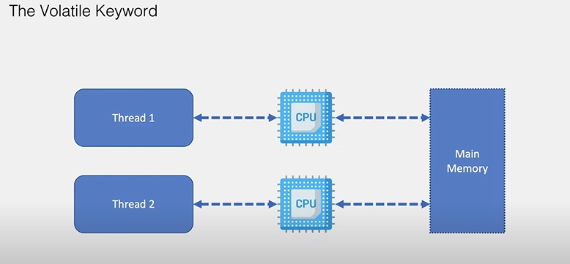

Slide 32
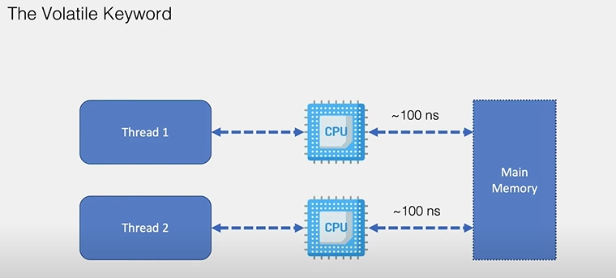

Slide 33
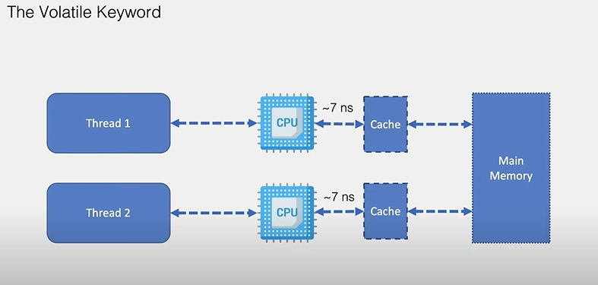

Slide 34
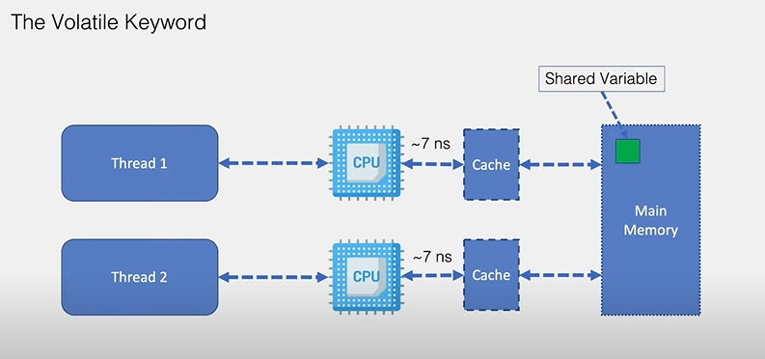

Slide 35
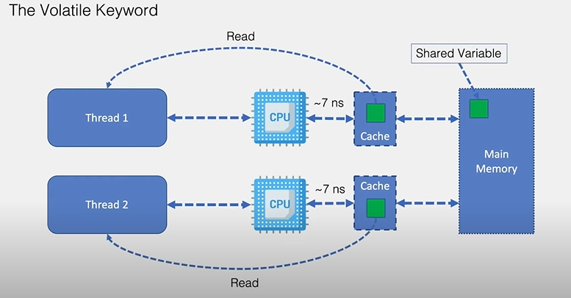

Slide 36
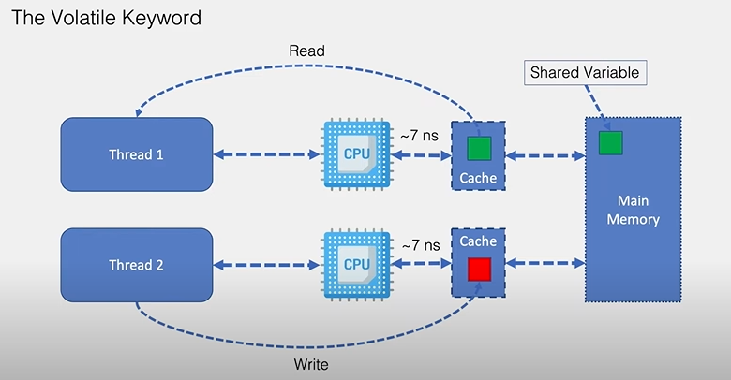

Slide 37
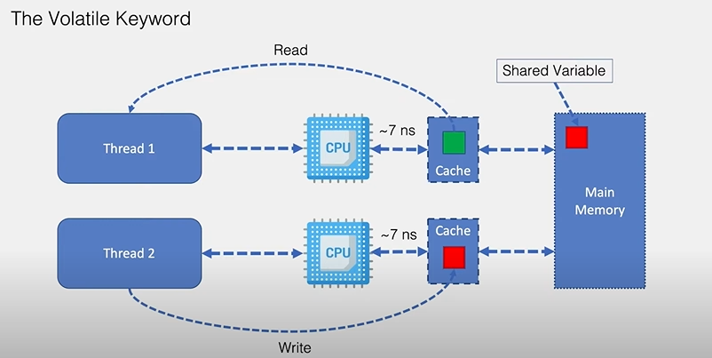

Slide 38
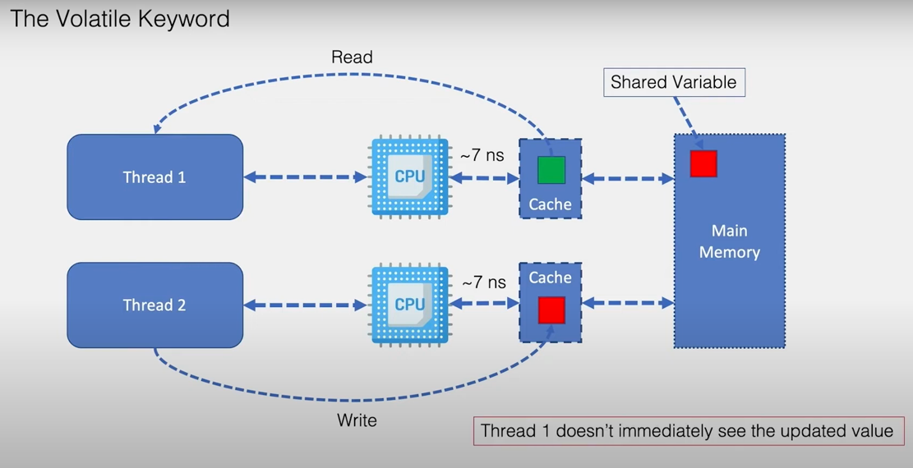

Slide 39
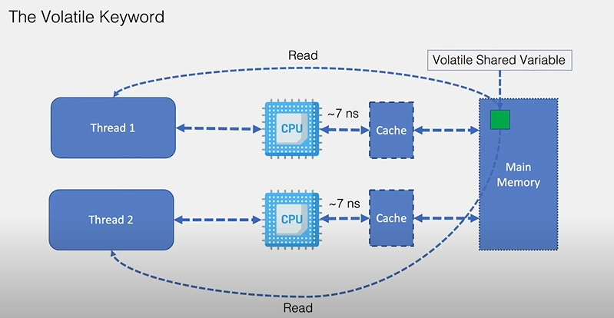

Slide 40
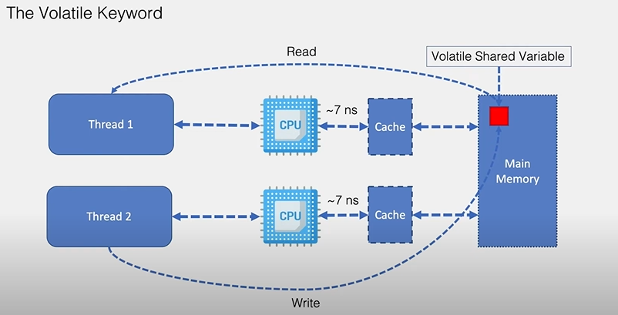

Slide 41
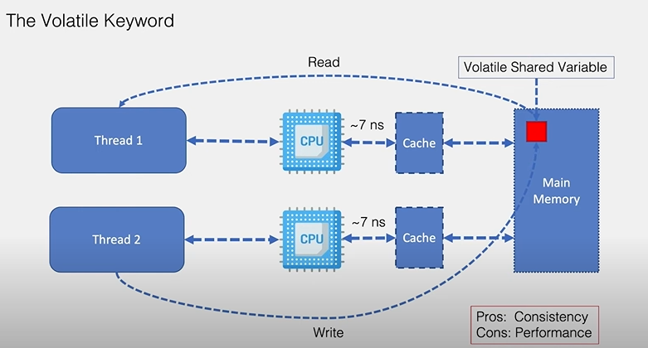

Slide 42
Where would you use Virtual Threads in your project?
I’d use Virtual Threads in I/O-heavy parts of the application to handle high concurrency efficiently.
REST APIs handling high concurrent user requests
Database calls (blocking I/O)
External service / API integrations
Message consumers with blocking operations
Why: Virtual Threads make blocking I/O cheap, allowing the app to scale to thousands or millions of concurrent requests without thread pool exhaustion.

Slide 43
How do Records improve code quality and reduce bugs?
They are immutable by default
Remove boilerplate (getters, constructor, equals, hashCode)
Reduce chances of state-related bugs
Clear intent → used for data carriers
Fewer lines of code → fewer mistakes
record User(int id, String name) {}

Slide 44
Why are Sealed classes useful in domain-driven design?
They control inheritance.
Restrict which classes can extend a domain type
Enforce business rules at compile time
Make domain models safe and explicit
Prevent invalid or unexpected domain states
Example:
sealed interface Payment permits Card, Upi, Cash {}

Slide 45
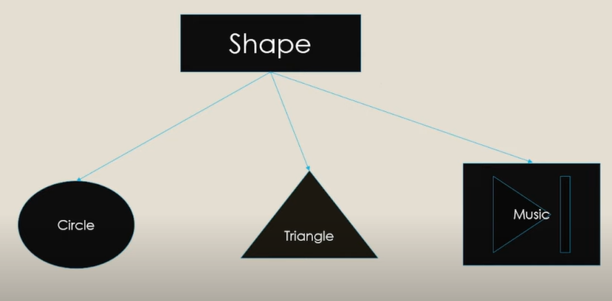

Slide 46
Person
Employee
Manager
Car

Slide 47
Why are Text Blocks preferred over traditional Strings in Java 17+?
Improve readability for multi-line strings
Eliminate excessive escape characters (\n, \")
Preserve formatting and indentation
Reduce bugs in SQL, JSON, HTML strings
Easier to maintain and refactor
// Before (hard to read)
String query = "SELECT * FROM users\n" +
"WHERE status = 'ACTIVE'\n" +
"ORDER BY created_at";
// Java 15+
String query = """
SELECT * FROM users
WHERE status = 'ACTIVE'
ORDER BY created_at
""";

Slide 48


